Slide 1
CHEAPER EXCHANGE OF INFORMATION VIA WIRELESS TECHNOLOGY
Supervisors:
Dr. Petronilla Muriithi
Prof. Waweru Mwangi
KAIRU JOSHUA WAMBUGU – CS281-0720/2011

Slide 2

Background and Introduction
The smart phone revolution.
How can smart phones connect and communicate with each other over wireless without a third party?

Slide 3

Literature Review
Four areas of concern:
Wireless Technologies
Peer-to-peer Technologies.
Audio Encoding Techniques.
Audio File Formats.

Slide 4

Wireless Technologies
Three will be looked at:
Near Field Communication
Bluetooth
Wireless Fidelity

Slide 5
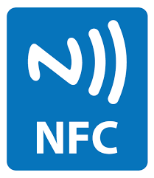
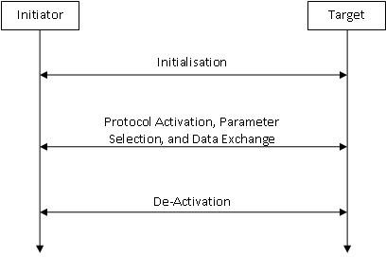
Near Field Communication(1)

Slide 6
Near Field Communication(2)
Excels over short distances (maximum 10 cm)
Short distance
Relatively new technology
Only small quantities of data

Slide 7
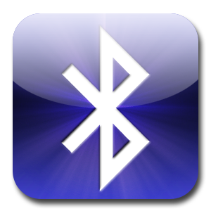
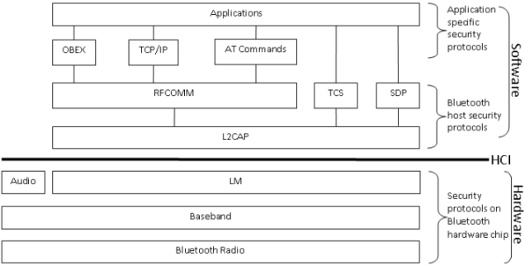
Bluetooth(1)
Notes:
Bluetooth radio. It transmits data in the form of bits by using a RF. This functionality is defined in the radio layer. Bluetooth radio systems generally use the Gaussian Frequency Shift Keying (GFSK) technique to transmit and receive RFs. • Baseband. This layer does frequency hopping for interference mitigation, medium access control, and data packet formation. In addition, the Baseband layer also control link, channel, and error correction and flow control. • Link Manager (LM). This layer acts as a go-between for the application and the link controller in the local Bluetooth device. Remember, the Baseband layer does link control. • Audio. The audio layer is almost on the same level with the LM layer. However, Audio is separated from LM so as to avoid the overhead of upper layer protocols. This is important since the Audio layer hosts protocols used to provide real time two way voice communication. The separation of Audio from LM ensures voice communication does to experience lag due to LM protocols. 11 • Logical Link Control and Adaptation Protocol (L2CAP). This protocol is on a layer of its own. It normally resides on the host. L2CAP acts as a conduit for data on the connection link between the Baseband and host applications. L2CAP is used to ensure both connectionoriented and connection-less services. This protocol also initiates security services for any Bluetooth communication session. • Radio Frequency COMMunication (RFCOMM). This is a transport protocol that is used to emulate RS-232 serial ports. It enables Bluetooth devices to connect with external gadgets such as printers and scanners. • Telephony Control Specification (TCS). This protocol defines the call control signalling needed for the establishment and/or release of speech and data calls between Bluetooth devices. It also proved functionality for exchanging signalling information that is not related to ongoing calls. • Service Discovery Protocol (SDP). This protocol is essential since it discovers the Bluetooth services available within the RF proximity and determines the characteristics of the available services. SDP is what allows Bluetooth devices to form ad-hoc, or peer-to-peer, networks. • Object EXchange Protocol (OBEX). OBEX is used to exchange objects between Bluetooth devices. These objects include calendar notes, business cards, and data files. The exchange is done based on a client-server model. • Transport Control Protocol/Internet Protocol (TCP/IP). This well-known protocol provides a reliable stream of data to Bluetooth applications from the RFCOMM layer. • ATtention (AT) commands. These are not protocols as such but are a set of commands used in general telecommunications to produce commands for management of communication sessions. • Applications. These are the Bluetooth applications used by end users.

Slide 8
Bluetooth(2)
Flexibility – Hardware and software.
Quite common
Relatively small range of operation (30 m)
Security issues

Slide 9

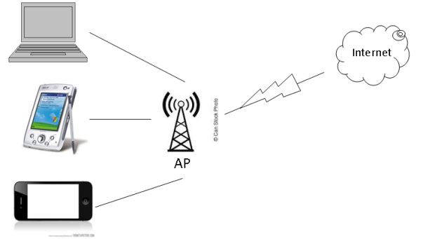
Wireless Fidelity (Wi-Fi)(1)

Slide 10
Wireless Fidelity (Wi-Fi)(2)
IEEE Standard | Maximum Speed (Megabytes per second) | Frequency (GigaHertz) | Backward Compatible with
802.11 | 2 | 2.4 | –
802.11a | 54 | 5 | –
802.11b | 11 | 2.4 | –
802.11g | 54 | 2.4 | 802.11b
802.11n | 600 | 2.4 and 5 | 802.11a/b/g

Slide 11
Wireless Fidelity (Wi-Fi)(3)
Longest range of the three technologies (maximum 100 m)
Very common
Security!!!
Power draw.

Slide 12

Peer to Peer Technologies
Two will be considered:
Short Message Peer to Peer protocol
Wi-Fi Direct

Slide 13
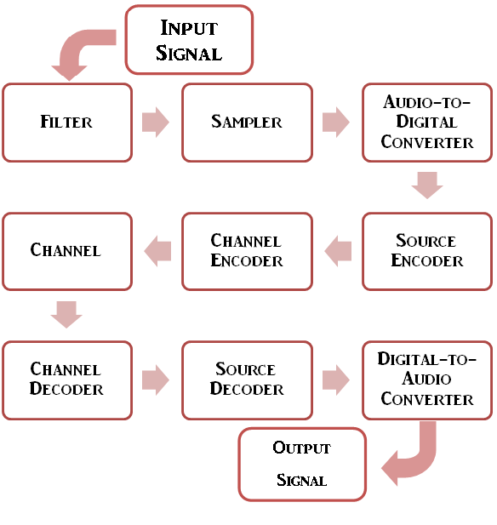
Audio Encoding Techniques
How is audio converted from
analog to digital?
Two ways:
Adaptive Multi-Rate Narrow Band (AMR-NB)
Adaptive Multi-Rate Wide Band
(AMR-WB)
Notes:
Difference is the quality and the acceptance.

Slide 14
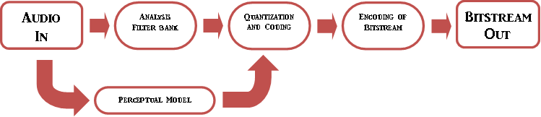
Audio File Formats(1)
Perceptual coding – Mind games.

Slide 15
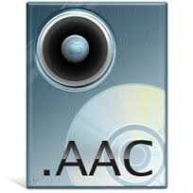

Audio File Formats(2)
Two common formats:
Motion Picture Experts Group-1/2 Layer-3 (MP3)
Advanced Audio Coding. (AAC)

Slide 16

What Will We Use?
Four areas of concern and what we will use:
Wireless Technologies – Wi-Fi
Peer-to-peer Technologies – We will implement this
Audio Encoding Techniques – AMR-WB
Audio File Formats – AAC.

Slide 17

GSM
Hallmark of Mobile communication
Distance
Security
Cost

Slide 18

Research Methodology
Experimentation:
Connection
Vary distance.
Vary audio.
Web search:
StackOverflow
Code questions
Interviews:
University students
Get views after each major build

Slide 19

THANK YOU

